Slide 1
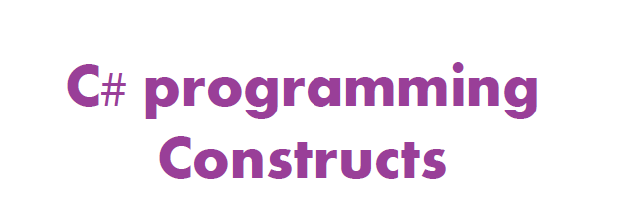

Slide 2
Conditional Operators
== equals
!= not equals
< less than
<= less than or equal
> greater than
>= greater than or equal
&& and
|| or

Slide 3
CONDITIONAL CONSTRUCTS
If… else… if

Slide 4
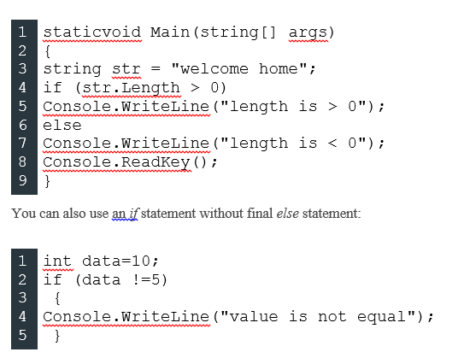
Example

Slide 5
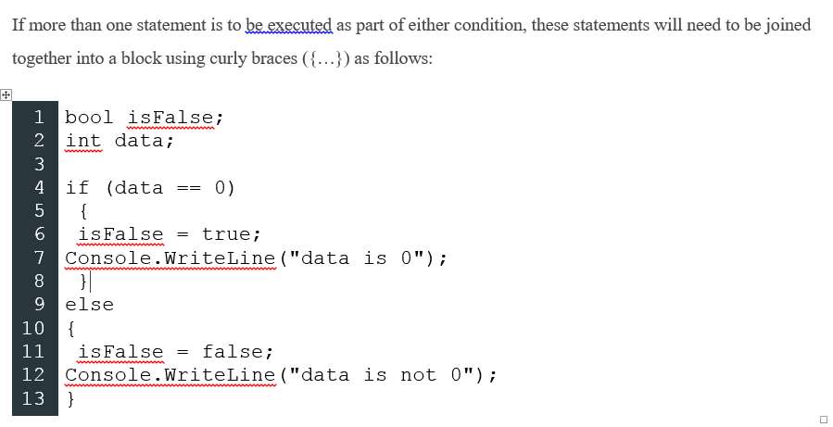

Slide 6
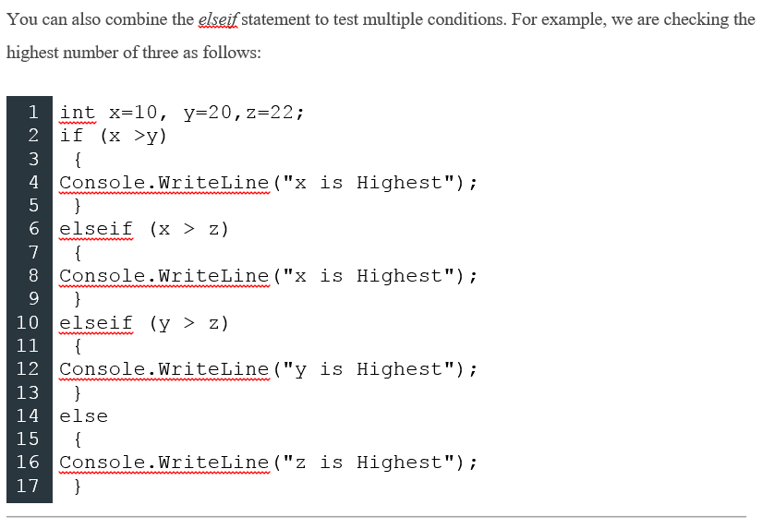

Slide 7
Short representation of condition
The conditional operator (?:) returns one of two values depending on the value of a Boolean expression. Following is the syntax for the conditional operator.
condition ? first_expression : second_expression;
String result = x<0? “Negative Number”:”Positive number”;

Slide 8
Null-coalescing operator ??
The ?? operator is called the null-coalescing operator. It returns the left-hand operand if the operand is not null; otherwise it returns the right hand operand.
// Set y to the value of x if x is NOT null; otherwise,
// if x = null, set y to -1.
int y = x ?? -1;

Slide 9
SELECTION CONSTRUCTS
Switch… case
The expression must be int, char, byte or short.

Slide 10
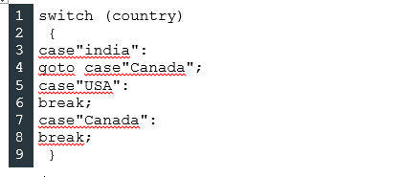

Slide 11
Loop Constructs
While (pre-test condition)

Slide 12
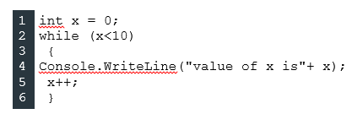

Slide 13
Loop constructs
Do-while (post-test condition)

Slide 14
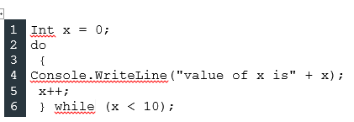

Slide 15
Loop Constructs
For(initialization;condition;operation)

Slide 16
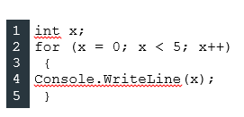

Slide 17
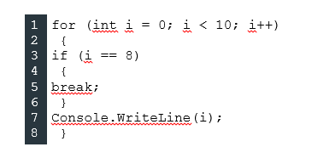

Slide 18
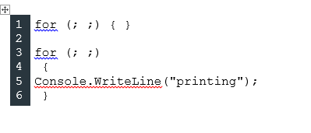

Slide 19
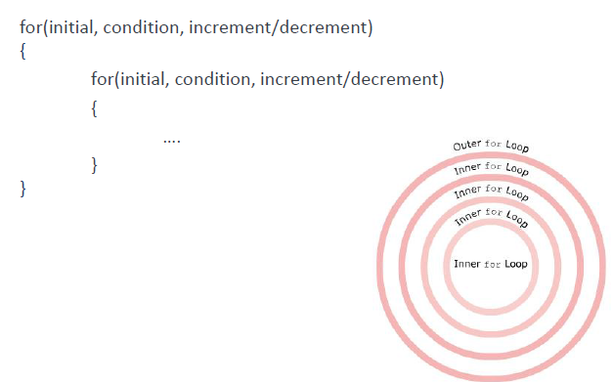
Possible nested loop

Slide 20
Loop (iterator)
Foreach()
Foreach(<datatype> <identifier> in <enumerable>)
{
}

Slide 21
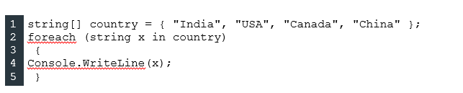

Slide 22
JUMP STATEMENTS
Break;
Used to exit the loop immediately;
Continue;
Used to jump to second iteration avoiding execution of code after the statement;
Goto;
Directly execute a labeled statement or a labeled block of statement
Can not use goto inside for, while or do-while loops
Return;
Exits immediately from the function

Slide 23
Classes, Members and Methods
Everything is encapsulated in a class
Can have:
member data
member methods
Class clsName
{
modifier dataType varName;
modifier returnType methodName (params)
{
statements;
return returnVal;
}
}

Slide 24
Class Constructors
Automatically called when an object is instantiated:
public className(parameters)
{
statements;
}

Slide 25
Hello World
namespace Sample
{ using System; public class HelloWorld { public HelloWorld() { } public static int Main(string[] args) { Console.WriteLine("Hello World!"); return 0; } }
}
Constructor

Slide 26
Another Example
using System;
namespace ConsoleTest
{
public class Class1
{
public string FirstName = "Kay";
public string LastName = "Connelly";
public string GetWholeName()
{
return FirstName + " " + LastName;
}
static void Main(string[] args)
{
Class1 myClassInstance = new Class1();
Console.WriteLine("Name: " + myClassInstance.GetWholeName());
while(true) ;
}
}
}

Slide 27
Summary
C# builds on the .NET Framework component model
New language with familiar structure
Easy to adopt for developers of C, C++, Java, and Visual Basic applications
Fully object oriented
Optimized for the .NET Framework

